Slide 1
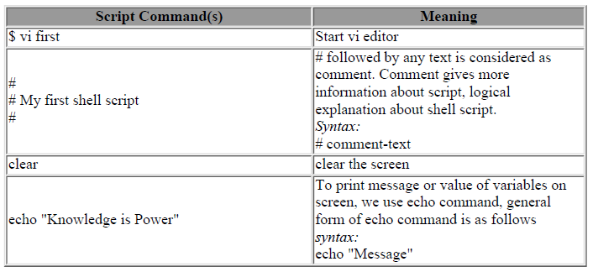
$ nano first # open a file named first
#
# My first shell script
#
clear
echo "Knowledge is Power“

Slide 2
$ vi ginfo
#
#
# Script to print user information who currently login , current date
& time
#
clear
echo "Hello $USER"
echo "Today is \c ";date
echo "Number of user login : \c" ; who | wc -l
echo "Calendar"
cal
exit 0

Slide 3
User defined variable declaration
variable name=value
$> no=10 # this is ok
$> 10=no # Error, NOT Ok, Value must be on right side of = sign.
To define variable called 'vech' having value Bus
$> vech=Bus
To define variable called n having value 10
$> n=10
Rules for naming
Variable name must begin with Alphanumeric character or underscore character (_), followed by one or more Alphanumeric character.
Don't put spaces on either side of the equal sign when assigning value to variable
Variables are case-sensitive,
To print value 20 we have to use $ echo
You can define NULL variable
Do not use ?,* etc, to name your variable names

Slide 4
Shell Arithmetic
Syntax: expr op1 math-operator op2
$> expr 1 + 3
$> expr 2 - 1
$> expr 10 / 2
$> expr 20 % 3
$> expr 10 \* 3
$> echo `expr 6 + 3`
Exit status
(1) If return value is zero (0), command is successful.
(2) If return value is nonzero, command is not successful

Slide 5
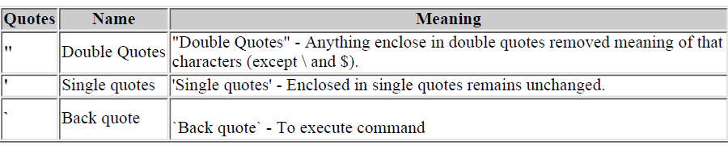
Example:
$ echo "Today is date"
Can't print message with today's date.
$ echo "Today is `date`".
It will print today's date as, Today is Tue Jan ....,

Slide 6
Read command
Use to get input (data from user) from keyboard and store (data) to variable.
Syntax: read variable1, variable2,...variableN
$ vi sayH
#
#Script to read your name from key-board
#
echo "Your first name please:"
read fname
echo "Hello $fname, Lets be friend!"

Slide 7
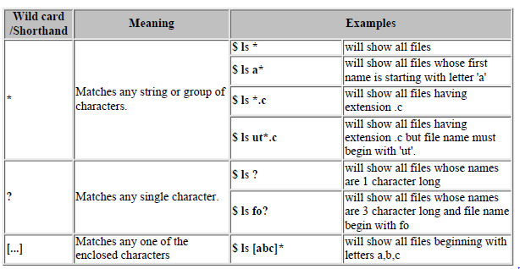
Wild card characters
More than one command execution from a command line
$> who; date

Slide 8
Redirection of standard input and output
There are three main redirection symbols >,>>,<
Redirector Symbol: > (Creates a new file)
Syntax: Linux-command > filename
ls > filename
Redirector Symbol: >> (Appends over existing file)
Syntax: Linux-command >> filename
date >> myfiles
Redirector Symbol : < (take the input to a command from file)
Linux-command < filename
cat < myfiles

Slide 9
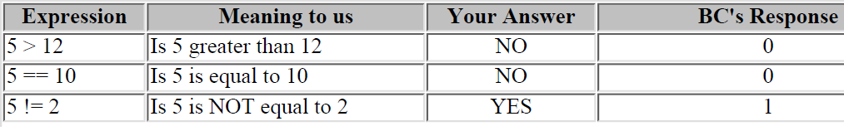
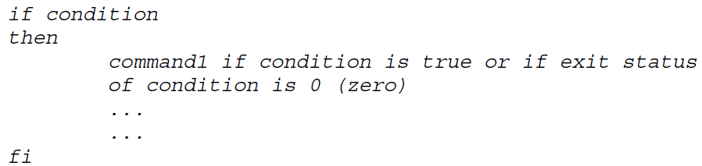
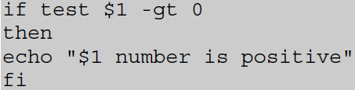
Decision making and loops
If condition
test command or [ expr ]
is used to see if an expression is true, and if it is true it return zero(0), otherwise returns nonzero for false

Slide 10
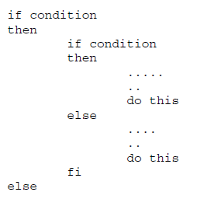
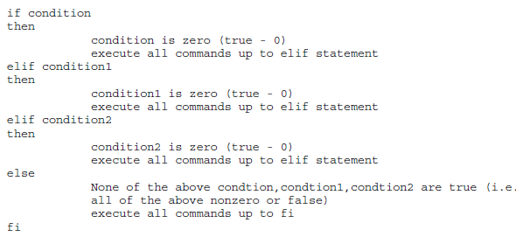

Slide 11
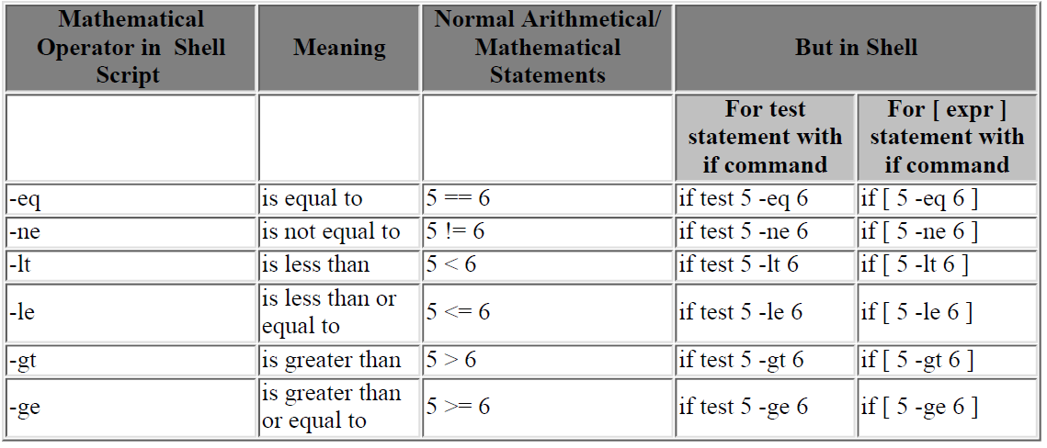

Slide 12
For loop
for { variable name } in { list }
do
execute one for each item in the list until the list is
not finished (And repeat all statement between do and done)
done
While loop
while [ condition ]
do
command1
command2
command3
done

Slide 13
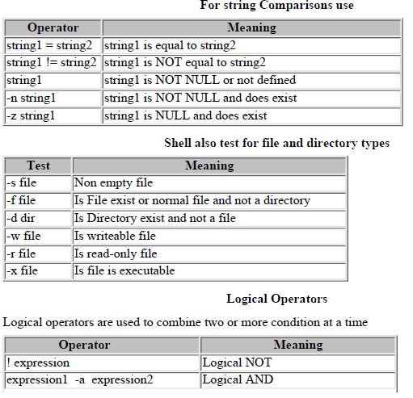

Slide 14
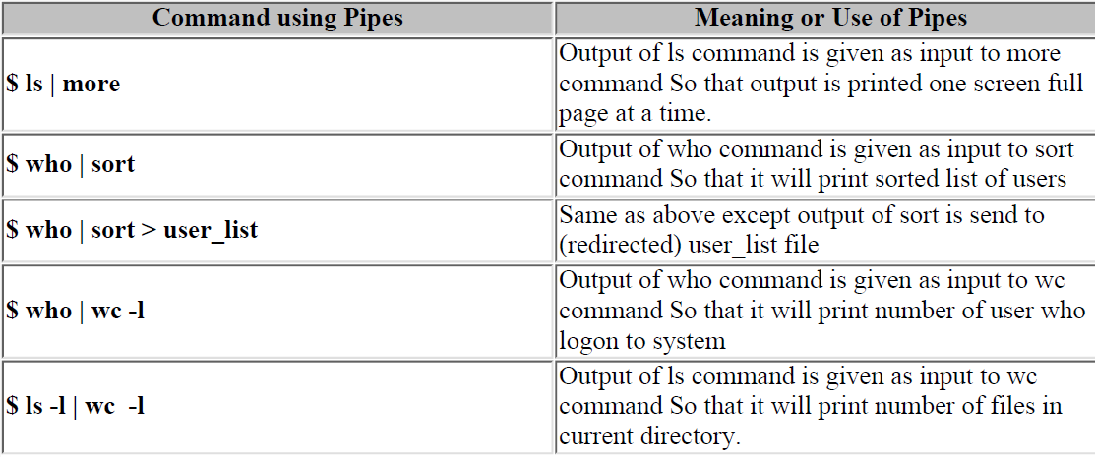
Pipes example

